Slide 1

資料結構 Data Structure
Chap.02 Stacks and Queues
Ming-Han Tsai
2020 Spring

Slide 2
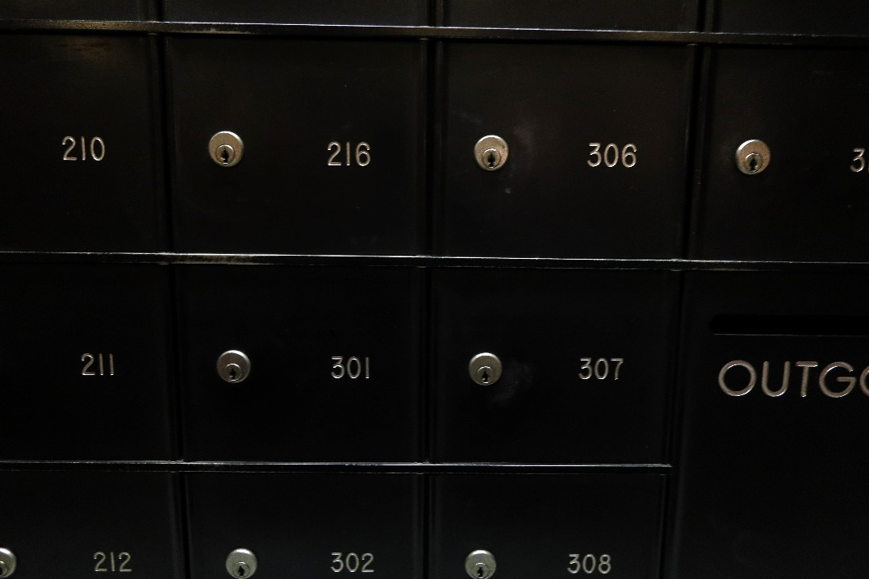
陣列(Array)
陣列(array)由一連串的索引(index)和值(value)構成
對每個索引index，必有一個相關聯的值value
如果可能的話，盡量使用連續空間的記憶體
減少存取時間

Slide 3
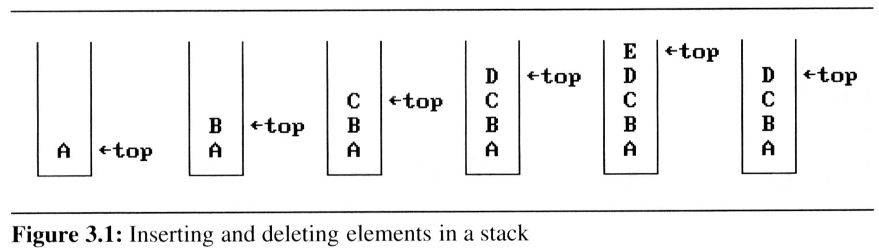
The stack(堆疊) ADT
A stack is an ordered list in which insertions and deletions are made at one end called the top.
插入和刪除只作用於最頂層的元素：top
If we add the elements A, B, C, D, E to the stack, in that order, then E is the first element we delete from the stack
A stack is also known as a Last-In-First-Out (LIFO) list. => 後進先出
C
Top
B
Top
A
Top

Slide 4
The stack ADT
記憶體中的函數呼叫方式
fp
al
(activation record)
fp: a pointer to current stack frame
fp
main
fp
main
stack frame of invoking function
system stack before a1 is invoked
system stack after a1 is invoked
(a) (b)
*Figure 3.2: System stack after function call a1 (p.103)

Slide 5
Recall：遞迴(recursive)

Slide 6
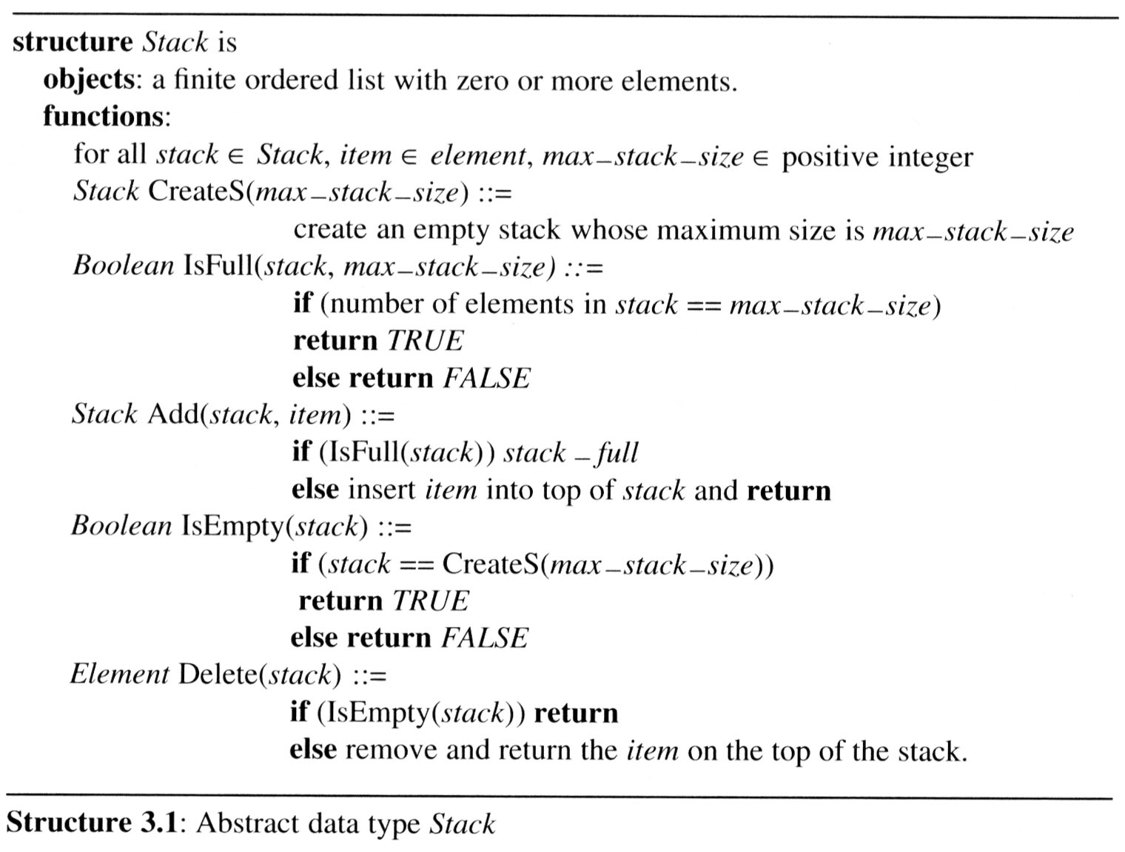
The stack ADT

Slide 7
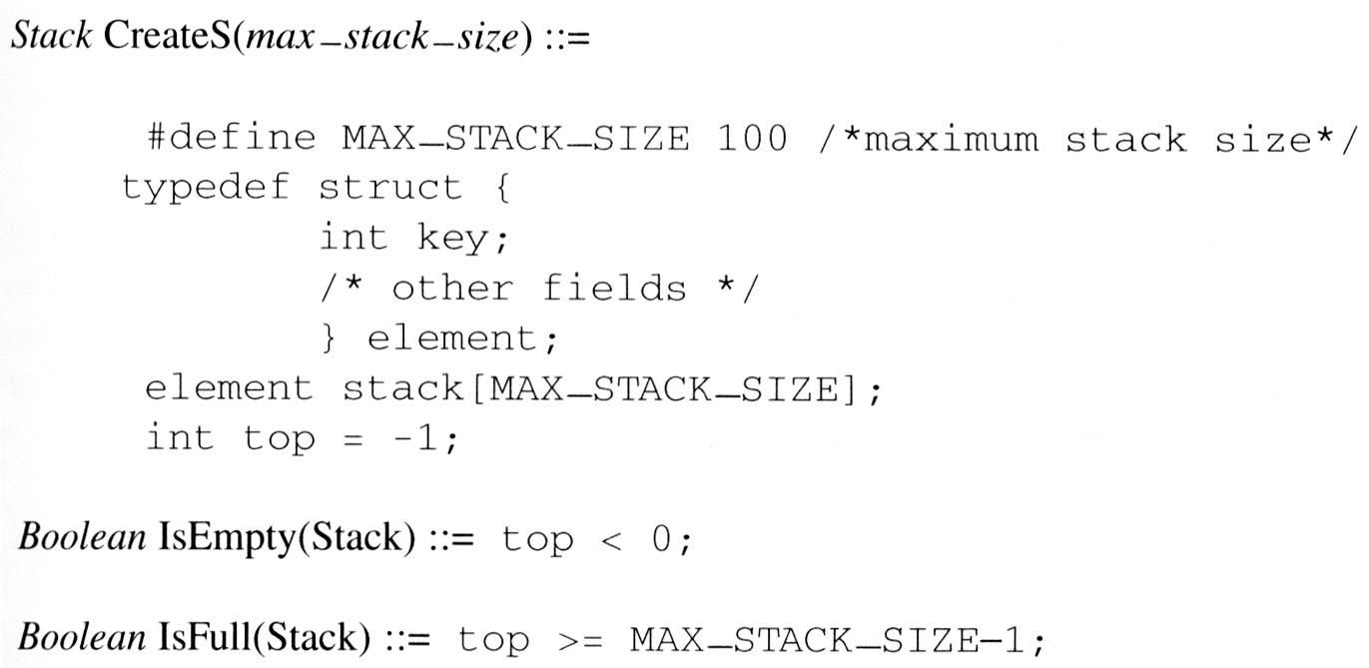
The stack ADT
Implementation: using array

Slide 8
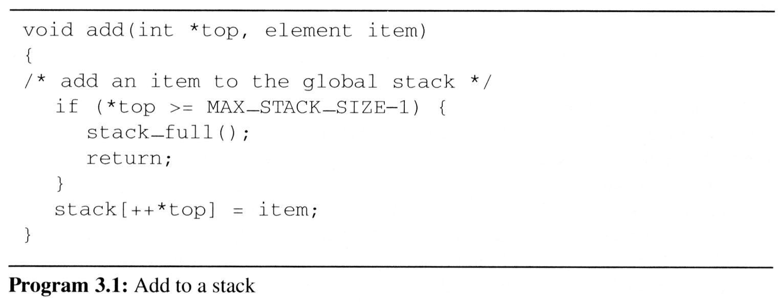
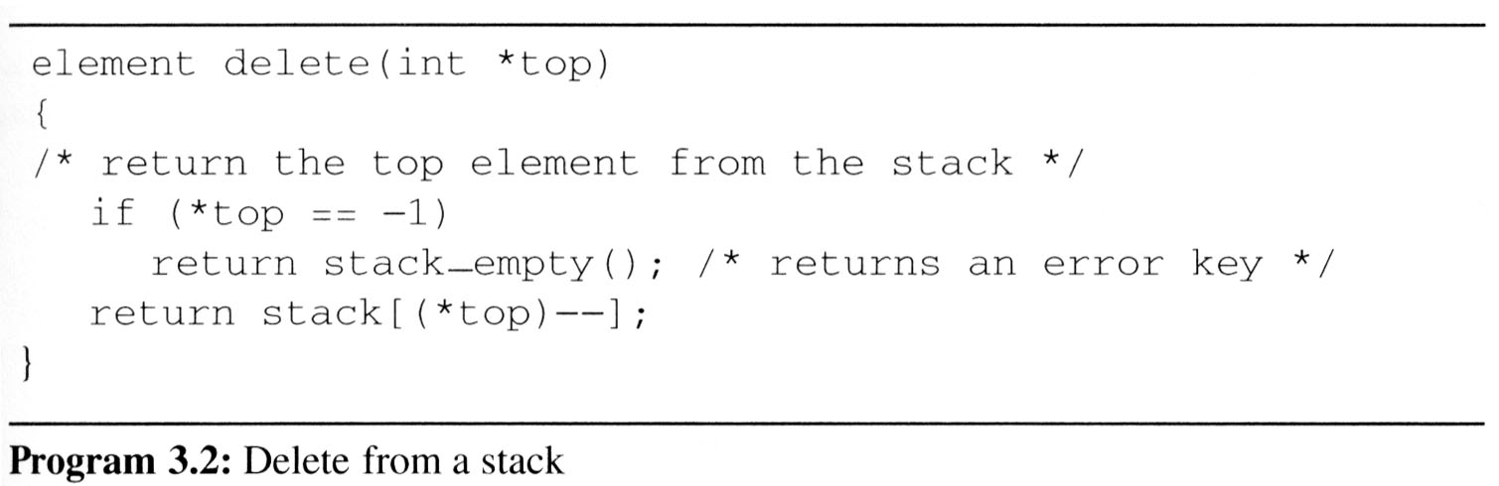
The stack ADT
stack
item
Top
stack
item
Top

Slide 9
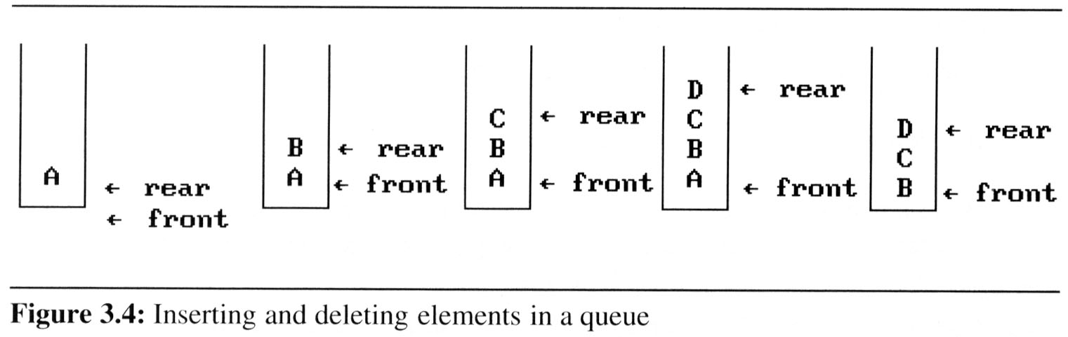
The queue(佇列) ADT
A queue is an ordered list in which all insertion take place one end, called the rear and all deletions take place at the opposite end called the front
First-In-First-Out (FIFO) list
先進先出；最後放進queue的元素要等前面都取光之後才能取出來
If we insert the elements A, B, C, D, E, in that order, then A is the first element we delete from the queue as a
C
Rear
B
Rear
A
Front

Slide 10
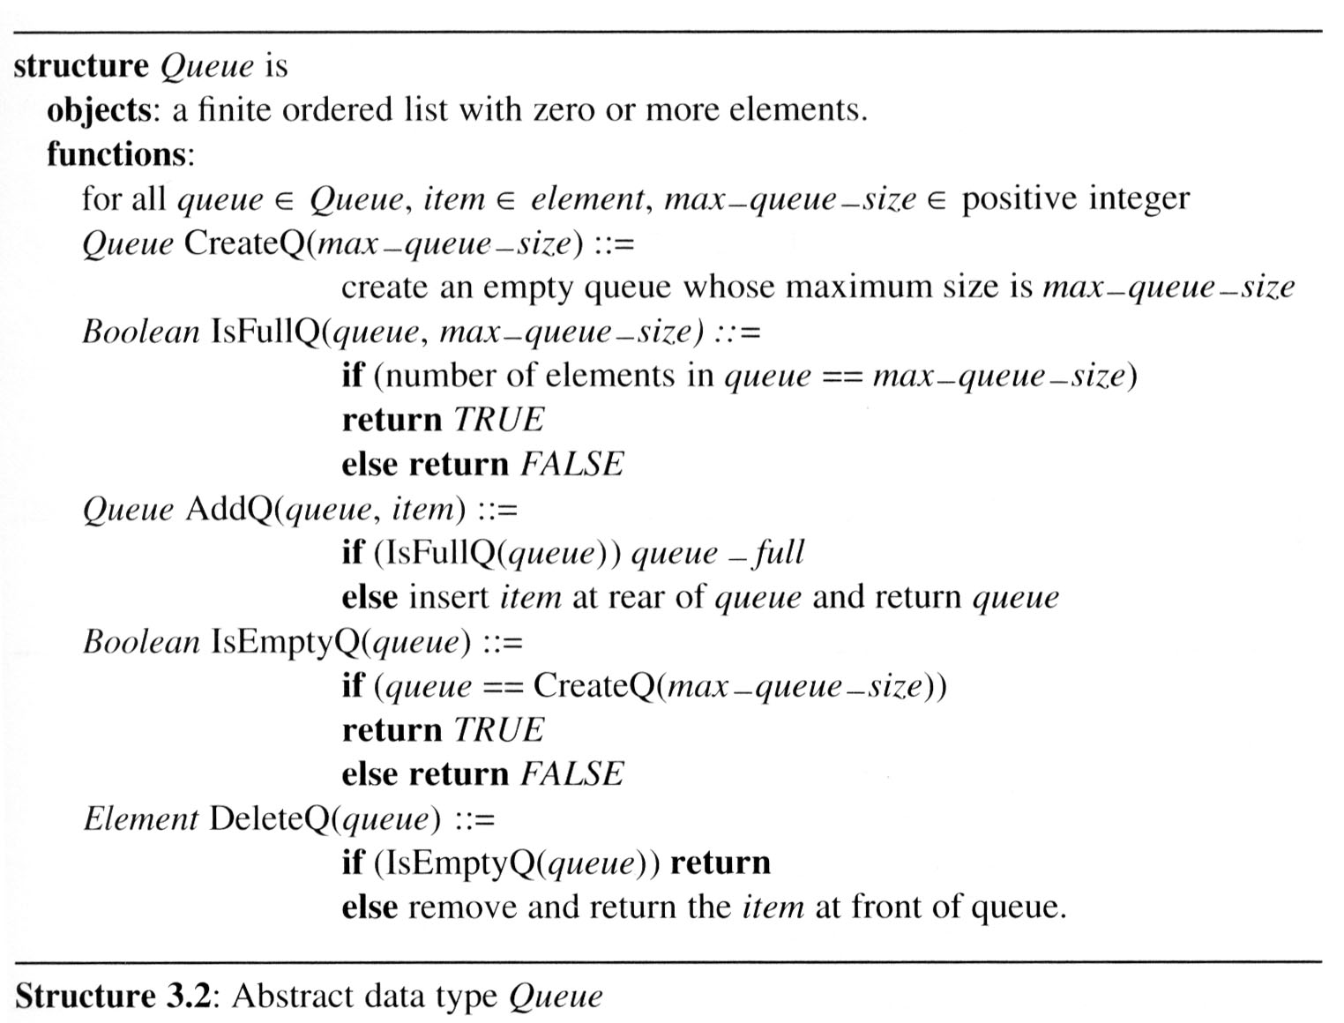
The queue ADT

Slide 11
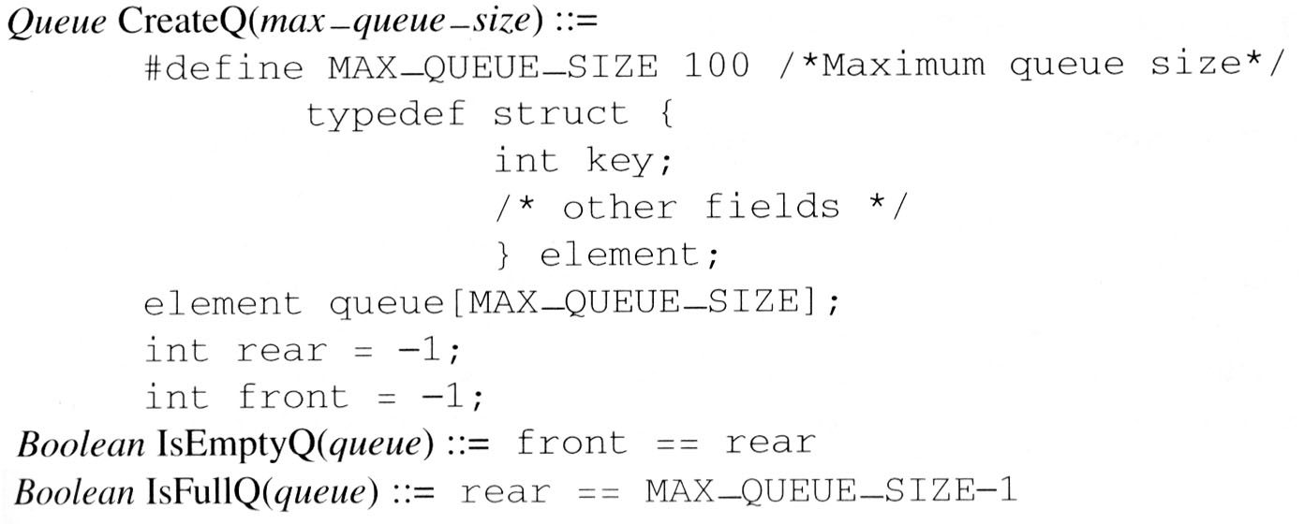
The queue ADT
MAX_QUEUE_SIZE
front
Implementation 1: using a one dimensional array and two variables, front and rear
rear

Slide 12
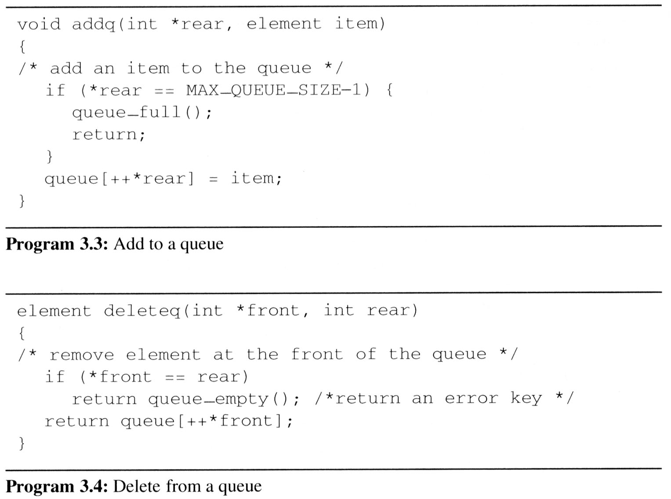
The queue ADT
MAX_QUEUE_SIZE
front
rear
MAX_QUEUE_SIZE
front
rear
problem: there may be available space when IsFullQ is true i.e. movement is required.

Slide 13
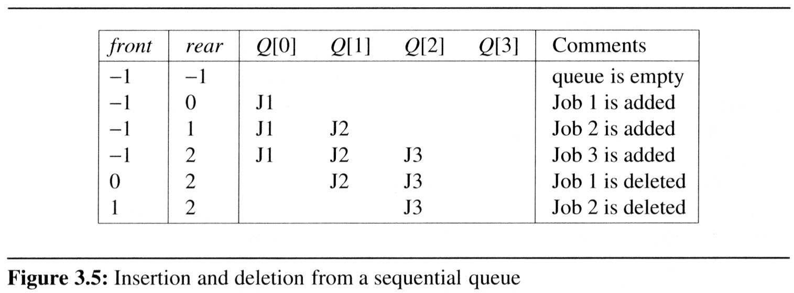
範例：工作排程Job scheduling
利用Queue來實作作業系統中的工作排程(循序)
當工作(job)進入/離開系統時，整個queue會往右移動
當queue_full時，整個queue必須由右移動(搬運)至最左邊，使第一個元素對齊到queue[0]，front=-1且rear=當時的工作數
MAX_QUEUE_SIZE
Shifting an array is very time-consuming, queue_full has a worst case complexity of O(MAX_QUEUE_SIZE).
front
rear

Slide 14
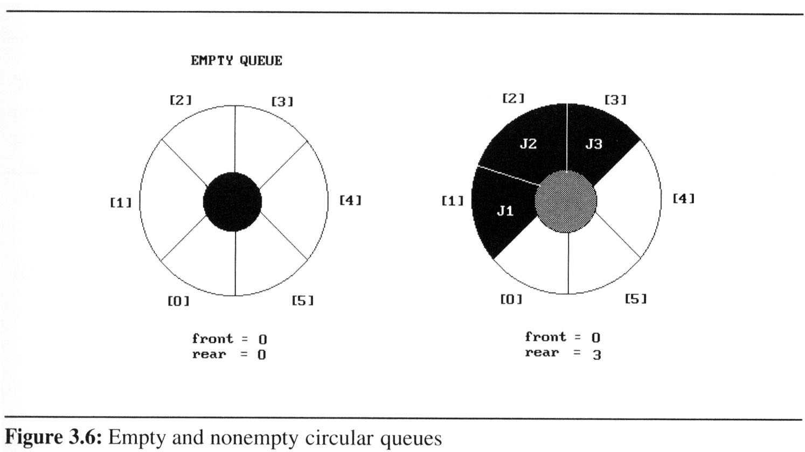
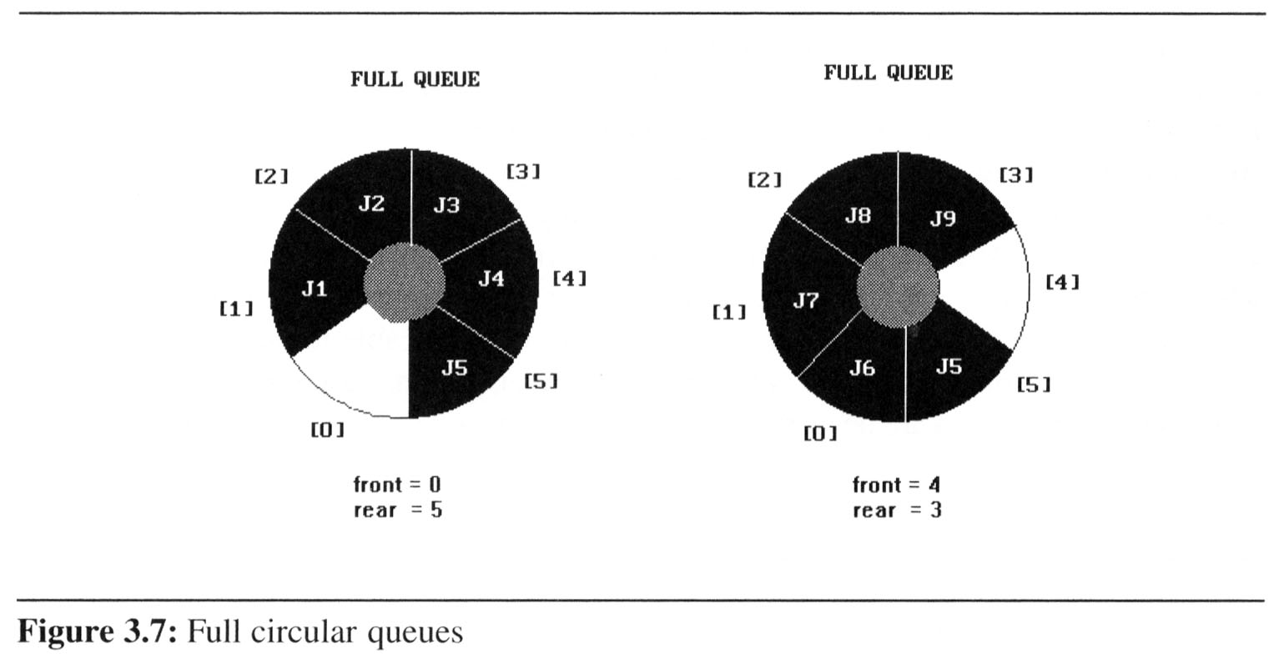
We can obtain a more efficient representation if we regard the array queue[MAX_QUEUE_SIZE] as circular.
Implementation 2: circular queue
front: one position counterclockwise from the first element
rear: current end
Problem: one space is left when queue is full.

Slide 15
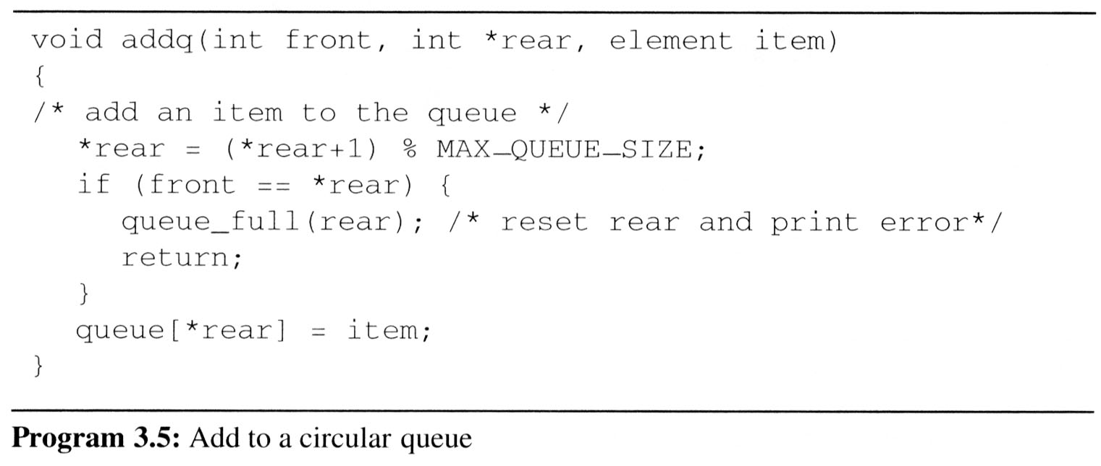
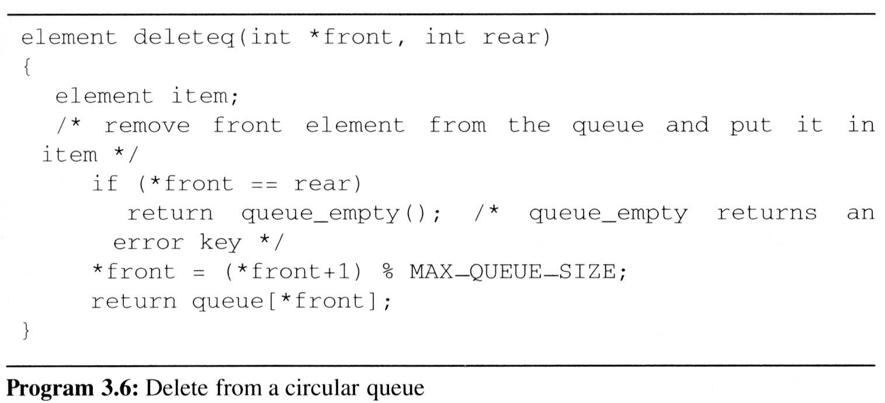
Implementing addq and deleteq for a circular queue is slightly more difficult since 需要考慮繞過一圈的情形

Slide 16
走迷宮問題
0 1 0 0 0 1 1 0 0 0 1 1 1 1 1
1 0 0 0 1 1 0 1 1 1 0 0 1 1 1
0 1 1 0 0 0 0 1 1 1 1 0 0 1 1
1 1 0 1 1 1 1 0 1 1 0 1 1 0 0
1 1 0 1 0 0 1 0 1 1 1 1 1 1 1
0 0 1 1 0 1 1 1 0 1 0 0 1 0 1
0 1 1 1 1 0 0 1 1 1 1 1 1 1 1
0 0 1 1 0 1 1 0 1 1 1 1 1 0 1
1 1 0 0 0 1 1 0 1 1 0 0 0 0 0
0 0 1 1 1 1 1 0 0 0 1 1 1 1 0
0 1 0 0 1 1 1 1 1 0 1 1 1 1 0
入口
出口
1: 不能通過 0: 可以通過
*Figure 3.8: An example maze(p.113)

Slide 17
方向的表示方式
*Figure 3.9: Allowable moves (p.113)

Slide 18
typedef struct { short int vert; short int horiz; } offsets; offsets move[8]; /*array of moves for each direction*/
a possible implementation
next_row = row + move[dir].vert; next_col = col + move[dir].horiz;

Slide 19
#define MAX_STACK_SIZE 100 /*maximum stack size*/ typedef struct { short int row; short int col; short int dir; } element; element stack[MAX_STACK_SIZE];
利用Stack來記錄走過的路徑

Slide 20
Initialize a stack to the maze’s entrance coordinates and direction to north; while (stack is not empty){ /* move to position at top of stack */ <row, col, dir> = delete from top of stack; while (there are more moves from current position) { <next_row, next_col > = coordinates of next move; dir = direction of move; if ((next_row == EXIT_ROW)&& (next_col == EXIT_COL)) success; if (maze[next_row][next_col] == 0 && mark[next_row][next_col] == 0) {
取出步伐
可以走&沒有走過

Slide 21
/* legal move and haven’t been there */ mark[next_row][next_col] = 1; /* save current position and direction */ add <row, col, dir> to the top of the stack; row = next_row; col = next_col; dir = north; } } } printf(“No path found\n”); *Program 3.7: Initial maze algorithm (p.115)

Slide 22
The size of a stack?
000001
111110
100001
011111
100001
111110
100001
011111
100000
m*p
mp --> ┌ m/2┐p, mp --> ┌ p/2┐m
*Figure 3.11: Simple maze with a long path (p.116)

Slide 23
void path (void) { /* 輸出能走出迷宮的(其中一條)正確路徑(如果存在) */ int i, row, col, next_row, next_col, dir, found = FALSE; element position; mark[1][1] = 1; top =0; stack[0].row = 1; stack[0].col = 1; stack[0].dir = 1; while (top > -1 && !found) { position = delete(&top); row = position.row; col = position.col; dir = position.dir; while (dir < 8 && !found) { /*往dir的方向移動*/ next_row = row + move[dir].vert; next_col = col + move[dir].horiz;
(1,1)
(m,p)
(m+2)*(p+2)
0
7 N 1
6 W E 2
5 S 3
4

Slide 24
if (next_row==EXIT_ROW && next_col==EXIT_COL) found = TRUE; else if ( !maze[next_row][next_col] && !mark[next_row][next_col] { /* 不是牆壁 而且 沒有走過*/ mark[next_row][next_col] = 1; position.row = row; position.col = col; position.dir = ++dir; add(&top, position); row = next_row; col = next_col; dir = 0; } else ++dir; } }
放入目前位置 + 下一步要走的方向

Slide 25
if (found) { printf(“The path is :\n”); printf(“row col\n”); for (i = 0; i < top; i++) printf(“ %2d%5d”, stack[i].row, stack[i].col); printf(“%2d%5d\n”, row, col); printf(“%2d%5d\n”, EXIT_ROW, EXIT_COL); } else printf(“The maze does not have a path\n”); } *Program 3.8:Maze search function (p.117)

Slide 26
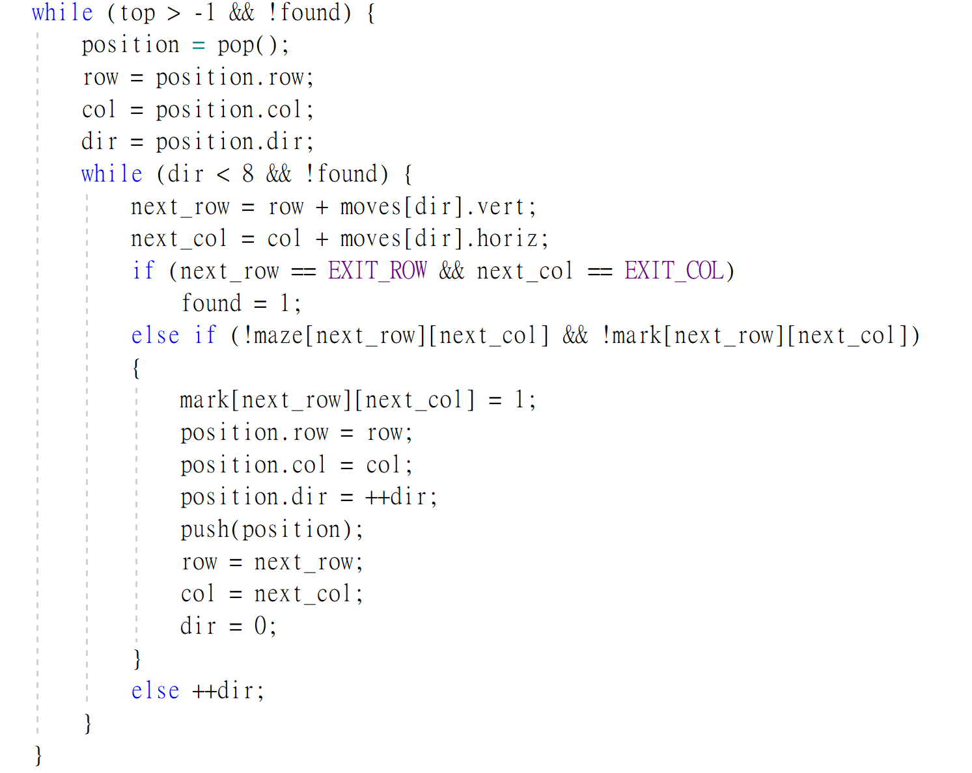
Maze
1 1 1 1 1
1 0 0 0 1
1 1 1 0 1
1 0 0 0 1
1 1 1 1 1
0
7 N 1
6 W E 2
5 S 3
4

Slide 27
Maze
1 1 1 1 1
1 0 0 0 1
1 0 1 1 1
1 0 0 0 1
1 1 1 1 1
0
7 N 1
6 W E 2
5 S 3
4

Slide 28
0
7 N 1
6 W E 2
5 S 3
4
Mark
Maze
1 1 1 1 1
1 0 0 0 1
1 0 1 1 1
1 0 0 0 1
1 1 1 1 1
1 1 1 1 1
1 0 0 0 1
1 0 1 1 1
1 0 0 0 1
1 1 1 1 1
1
1
1
0
0
0
0
0
0
0
1
0
R2C1D4
0
R1C2D6
0
R1C2D3
R1C1D3
R1C1D1

Slide 29
O(m/2*p) 或者 O(m*p/2)
最多需要走幾步？
000001
111110
100001
011111
100001
111110
100001
011111
100000
0000001
0111110
0000001
0111111
0000001
0111110
0000001
0111111
0000000
m*p
Length = 31
Length = 15

Slide 30
Stack應用在走迷宮
總之先往前走，往前走到沒路走再回頭
深度優先(Depth-First)
走錯路的時候也會走到底才回頭
換個思考方式：
往每個方向都先走一步
看走到終點了沒？
沒有再往每個方向都走一步
再看走到終點了沒？
…
0
0
0
0
0000001
0111110
0000001
0111111
0000001
0111110
0000001
0111111
0000000
0
0
0
0
0

Slide 31
用Queue來達到上面的效果
從Queue取出第一個位子，將從該位子可以一步之內走到的位子都丟進Queue
深度優先(Depth-First)
距離原點K步的點都走完之後，才會踏入距離K+1步的點
想法很美好，但實際上
遍歷所有距離一步的位子、兩步的位子、…有點不切實際
有沒有折衷的辦法？
A* Algorithm 採用Priority Queue
0000001
0111110
0000001
0111111
0000001
0111110
0000001
0111111
0000000

Slide 32
數學表示式Expression
((rear+1==front) || ((rear==MAX_QUEUE_SIZE-1) && !front))
x = a/b - c+d*e - a*c
包含：
運算子 operators: ==, +, -, ||, &&, !
運算元 operands: rear, front, MAX_QUEUE_SIZE
括號 parentheses: ( )

Slide 33
Evaluation of Expressions
x = a/b - c+d*e - a*c
assume a = 4, b = c = 2, d = e = 3, finding out the value of x
Interpretation 1: ((4/2)-2)+(3*3)-(4*2) = 0+8+9 = 1
Interpretation 2: (4/(2-2+3))*(3-4)*2 = (4/3)*(-1)*2 = -2.66666…
實際上我們利用括號(parentheses)改變計算的先後順序:
x = ((a/(b - c+d))*(e - a)*c
如何將表示式轉換成一連串的機器運算？
運算子的先後順序 precedence rule
結合律 associative rule

Slide 34
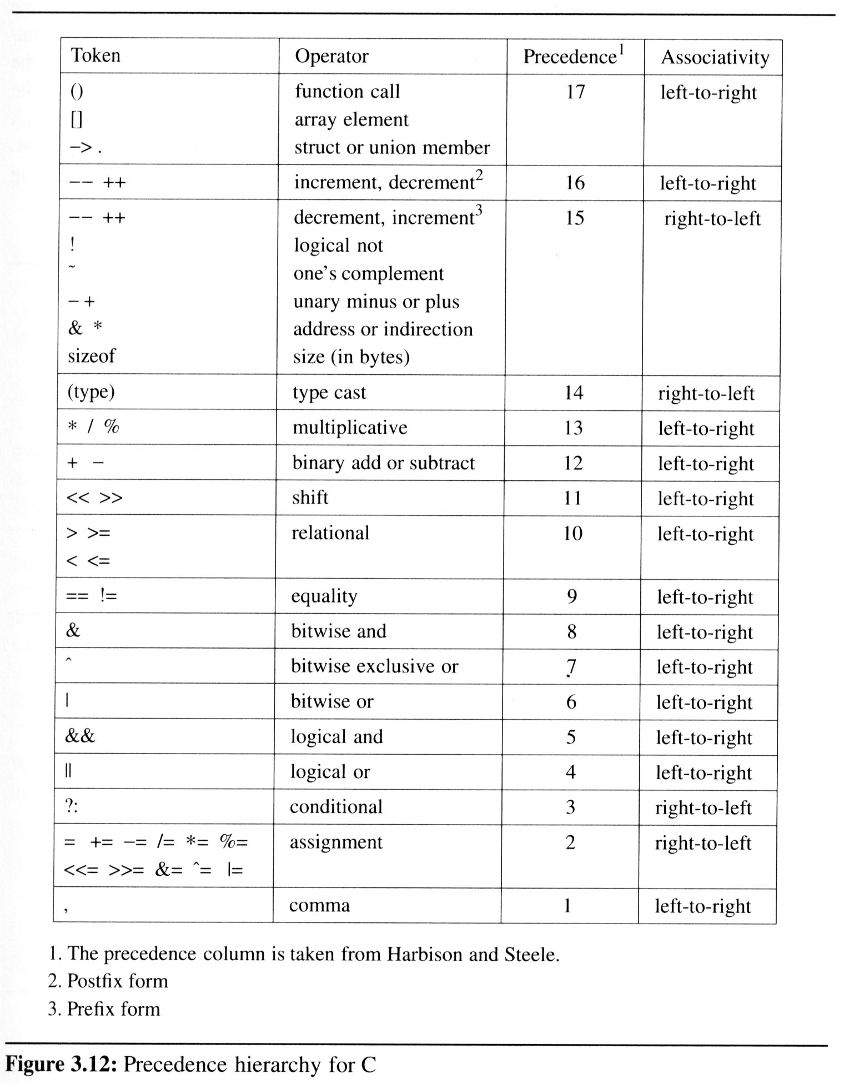
Precedence hierarchy and associative for C

Slide 35
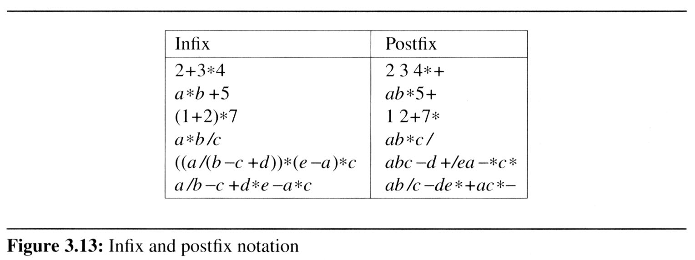
Evaluation of Expressions
Infix(中置式) and postfix(後置式)
最標準的表示式寫法多為中置式 infix notation
二元運算子會放在兩個運算元之中，如：2+3
由於運算先後和括號的問題，中置式並不是編譯器真正用來計算表示式的方法
實際上編譯器常用的是後置式(postfix)
Postfix:
沒有括號
不須考慮優先序

Slide 36
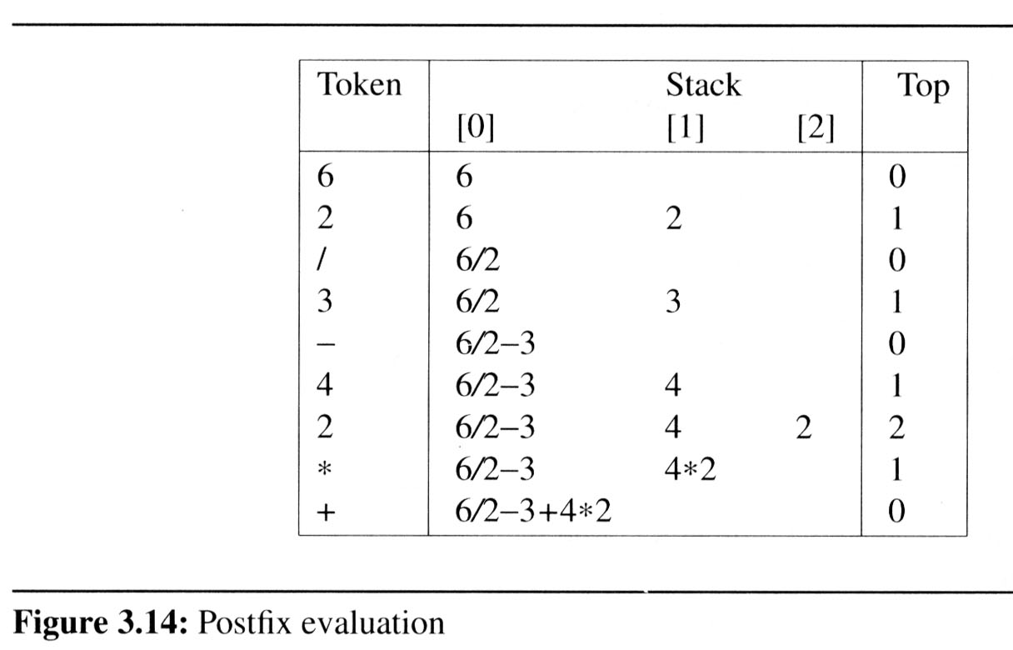
Evaluation of Expressions
計算後置式的表示式比中置式簡單:
不須考慮括號
只需要由左至右掃描過一遍
利用Stack可以簡單計算
Figure 3.14 shows this processing when the input is nine character string 6 2/3-4 2*+

Slide 37
6 2 / 3 - 4 2 * +
計算
4*2
計算6/2
計算
3-3
8
0
3
2
3
4
2
6
讀到運算子(符號)：從Stack取出兩個數做運算
讀到運算元(數字)：放入Stack

Slide 38
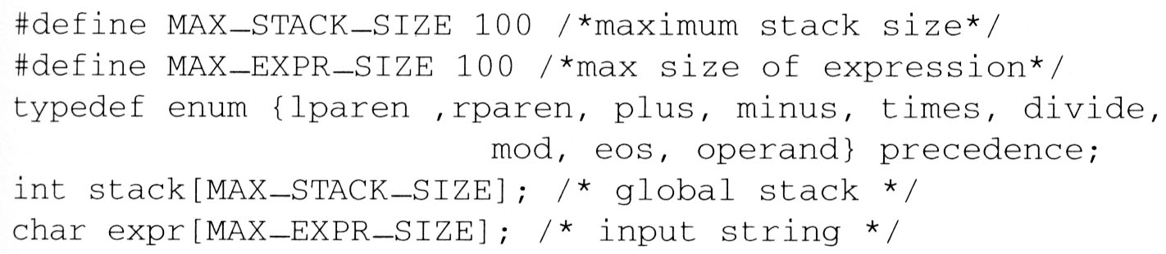
3.4 Evaluation of Expressions (6/14)
Representation
We now consider the representation of both the stack and the expression

Slide 39
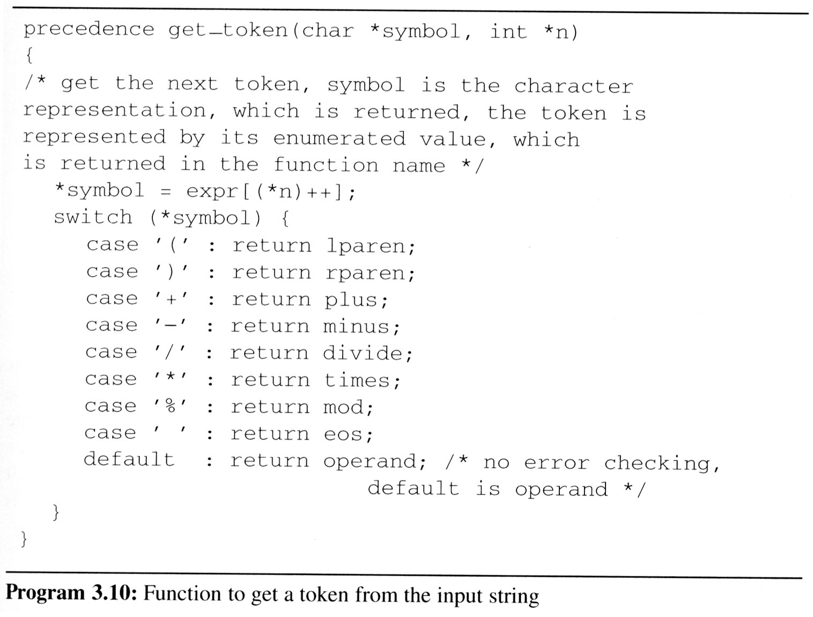
3.4 Evaluation of Expressions (7/14)
Get Token

Slide 40
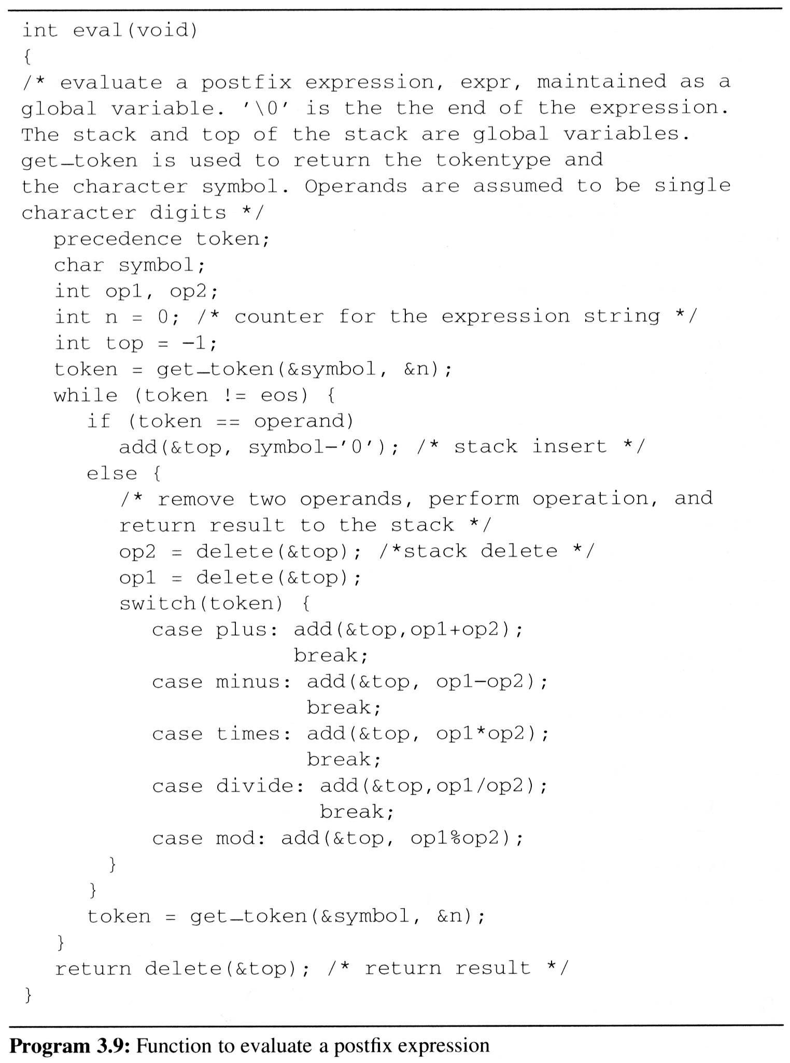
3.4 (8/14)
Evaluation of Postfix Expression

Slide 41
3.4 Evaluation of Expressions (9/14)
string: 6 2/3-4 2*+
we make a single left-to-right scan of it
add the string with the operator
6 2 / 3 - 4 2 * +
2
2
the answer is
not an operator, put into the stack
not an operator, put into the stack
is an operator, pop two elements of the stack
not an operator, put into the stack
is an operator, pop two elements of the stack
not an operator, put into the stack
not an operator, put into the stack
is an operator, pop two elements of the stack
is an operator, pop two elements of the stack
end of string, pop the stack and get answer
1
2
3
4
4*2
6 / 2 - 3 + 4 * 2
6
6/2
6/2-3
0
6/2-3+4*2
top
STACK
now, top must +1
now, top must -2
now, top must -1

Slide 42
3.4 Evaluation of Expressions (10/14)
We can describe an algorithm for producing a postfix expression from an infix one as follows
EX: Trans a / b - c + d * e - a * c To postfix
(1) Fully parenthesize expression
a / b - c + d * e - a * c
 ((((a / b) - c) + (d * e)) - (a * c))
(2) All operators replace their corresponding right parentheses
((((a / b) - c) + (d * e)) - (a * c))
(3)Delete all parentheses
a b / c - d e * + a c * -
 The order of operands is the same in infix and postfix
two passes
*
*
/
-
-
+

Slide 43
3.4 Evaluation of Expressions (11/14)
Algorithm to convert from infix to postfix
Assumptions:
operators: (, ), +, -, *, /, %
operands: single digit integer or variable of one character
Scan string from left to right
Operands are taken out immediately
Operators are taken out of the stack as long as their in-stack precedence (isp) is higher than or equal to the incoming precedence (icp) of the new operator
‘(‘ has low isp, and high icp
op ( ) + - * / % eos
Isp 0 19 12 12 13 13 13 0
Icp 20 19 12 12 13 13 13 0

Slide 44
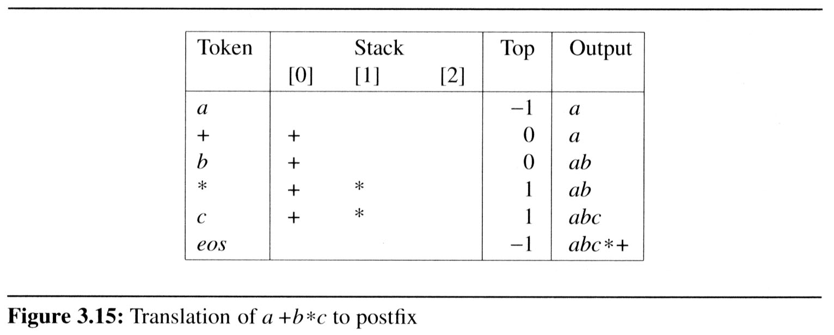
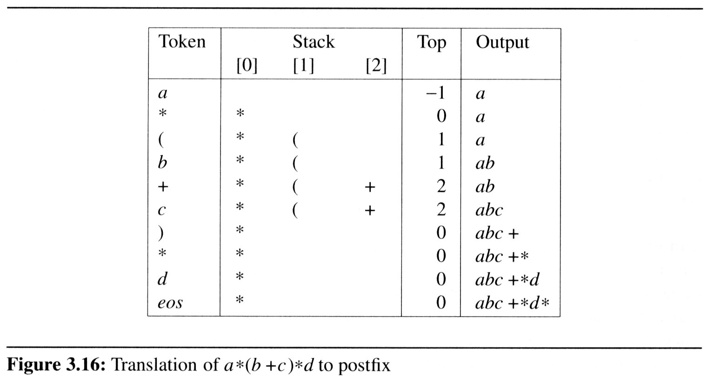
3.4 Evaluation of Expressions (12/14)
Example 3.3 [Simple expression]: Simple expression a+b*c, which yields abc*+ in postfix.
Example 3.5 [Parenthesized expression]: The expression a*(b+c)*d, which yields abc+*d* in postfix
icp
isp
EX: a+b*c
12
12
13
13
13
0
icp
isp
13
13
20
0
0
12
12
12
19
match )
13
13
13
13
0
13

Slide 45
3.4 Evaluation of Expressions (13/14)
a * ( b + c ) / d
operand, print out
operator
operator
operand, print out
operator
operand, print out
operator
operator
operand, print out
eos
push into the stack
+
pop the stack and printout
2
the isp of “( “ is 0 and the icp of “* “ is 13
the isp of “+“ is 12 and the icp of “( “ is 20
the isp of “/ “ is 13 and the icp of “* “ is 13
operator “)”, pop and print out until “(”
(
1
*
output
0
/
a
b
c
+
*
d
/
top
stack
now, top must +1
now, top must - 1

Slide 46
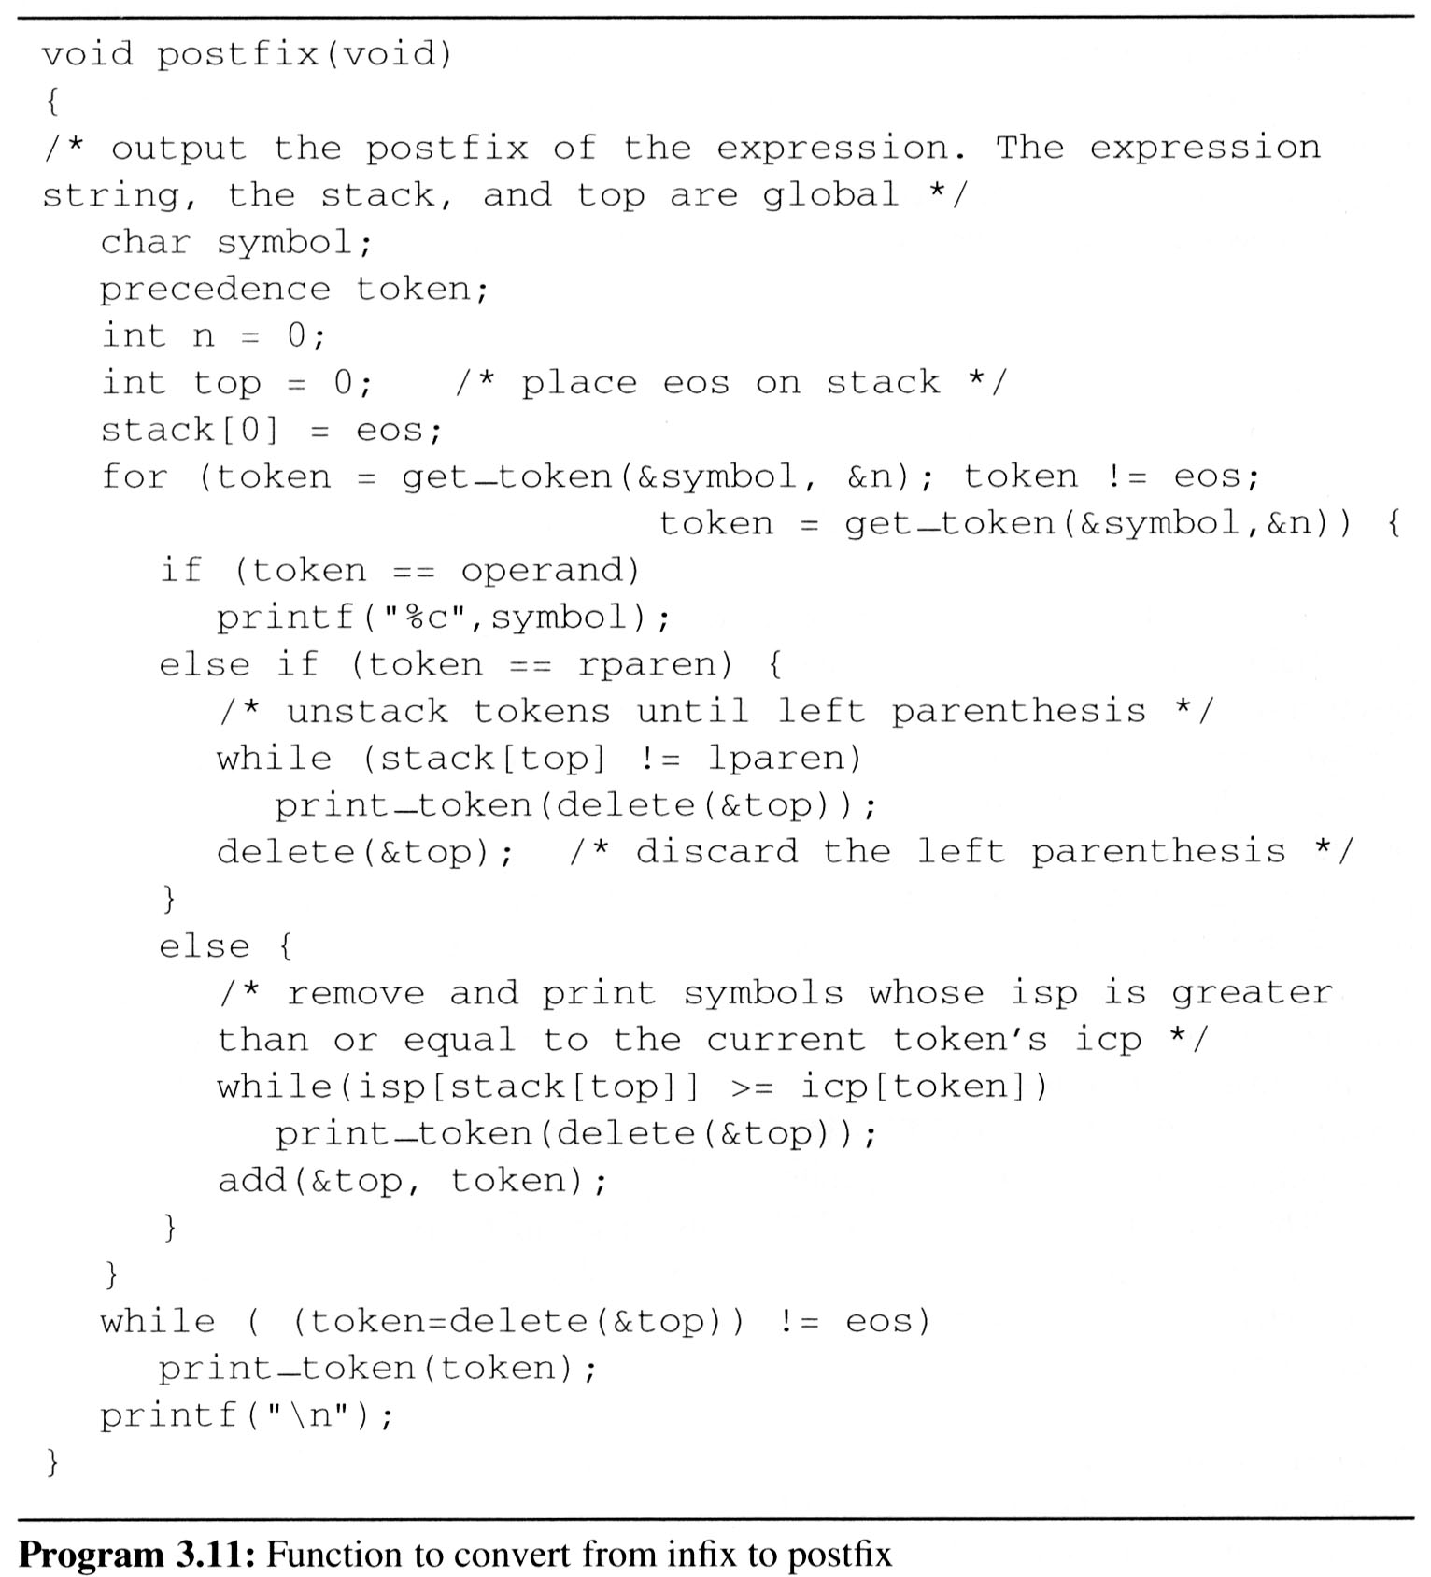
3.4 Evaluation of Expressions (14/14)
Complexity: Θ(n)
The total time spent here is Θ(n) as the number of tokens that get stacked and unstacked is linear in n
where n is the number of tokens in the expression

